Slide 1
E-SHOPPER Online-Shopping
November 2018

Slide 2
Team-members:
Daniel Zuemui -109376
Dawit Mebrahtu -986826
Henok Solomon -986506
Redae Mengsteab -109371
Advisor:
Professor Obinna Kalu

Slide 3
content
1.Introduction
2.Stating/Describing Problem Scenario
3.Main Use-Cases
3.1 Static Model(Main Class Diagram)
3.2 Data-Base Model(ER-Diagram)
3.3 Sequence Diagram
3.4 Software Design Patterns/Object Oriented Analysis
4. Future Enhancement
5. Demo

Slide 4
Introduction
Problem Description and benefit of online-shopping
The main purpose is to provide an easy shopping facility online and easy selling facilities to the customers of all categories.
Efficiency:- can be accessed and manage all shopping from secure site.
Convenience: customers can purchase items from the comfort of their own homes or workplace.
Shopping is made Easier and convenient for the customer through Internet. It is also easy to cancel the Transaction.

Slide 5
2. Stating/Describing the Problem Scenario
Problem Statement
Customer
Can browse through the product catalog and add items(products) to Cart.
Can create an account if he not yet has one.
Can proceed to check-out as long as his shopping cart is not Empty.
Will require to login to the system.

Slide 6
Seller
Can remove and update item quantity
Can easily browse through the catalog and places his product accordingly
Will require to login to the system.

Slide 7
Admin
-Provide accessibility to the E-Shoppers app
-Creates seller account
-Control over the seller & buyer activity
-Creates catalog

Slide 8
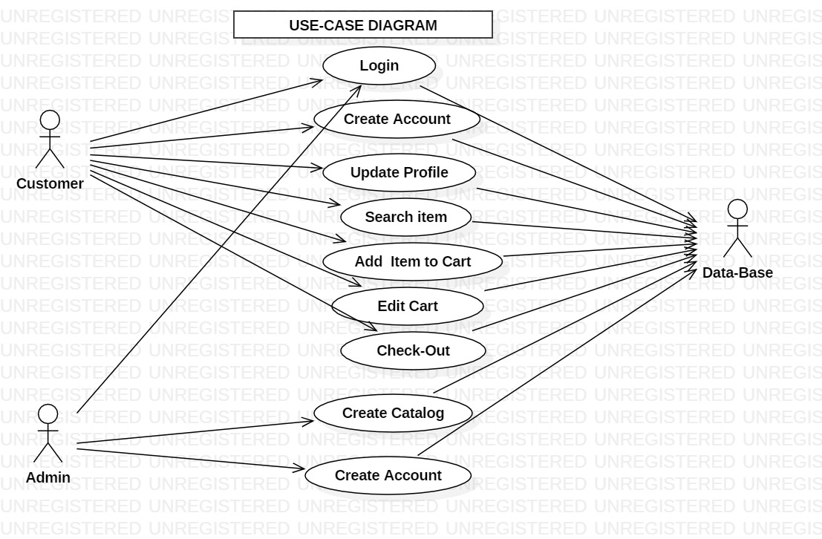
3.Main-Use-cases

Slide 9
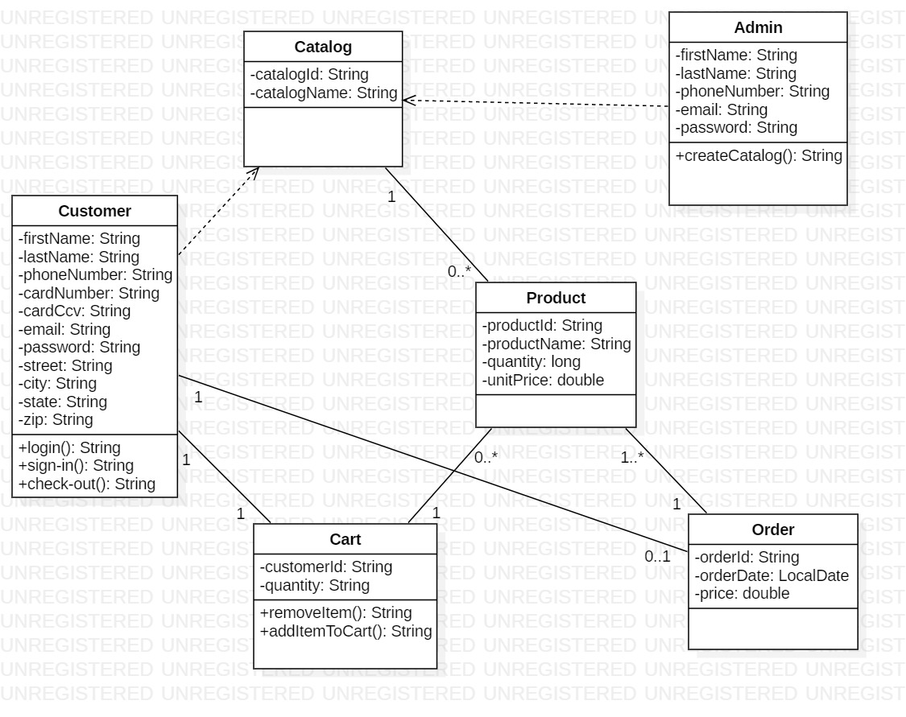
3.1 Static Model (Main Class Diagram)

Slide 10
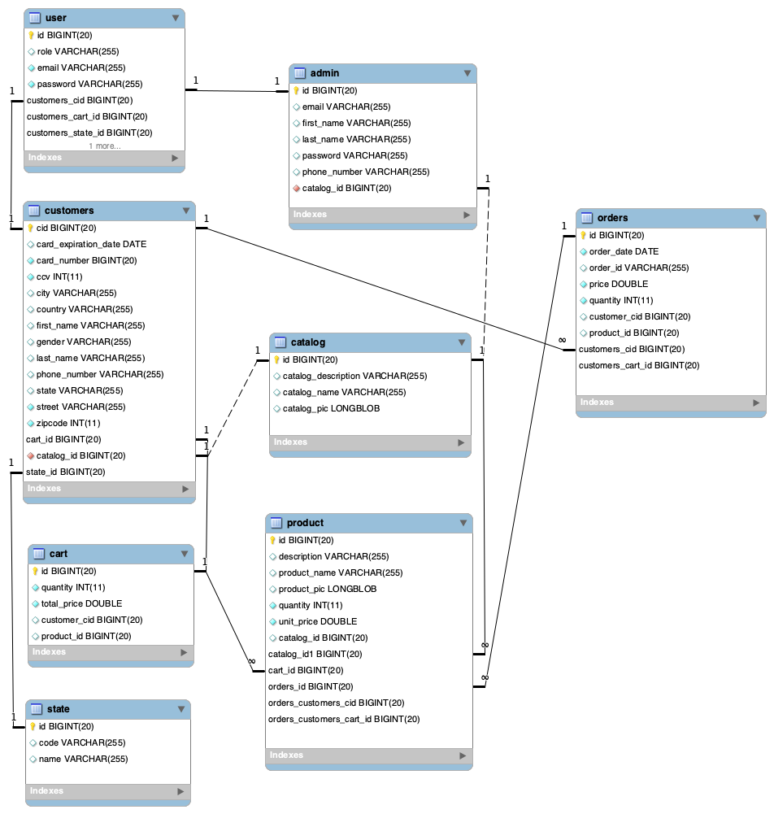
3.2 Data-Base Model(ER-Diagram)

Slide 11
Technology Used
Intellij IDEA and STS
Spring Boot
Hibernate
Spring Data
Spring Security
Hibernate Validation
Hibernate Transaction
DB: My-sql

Slide 12
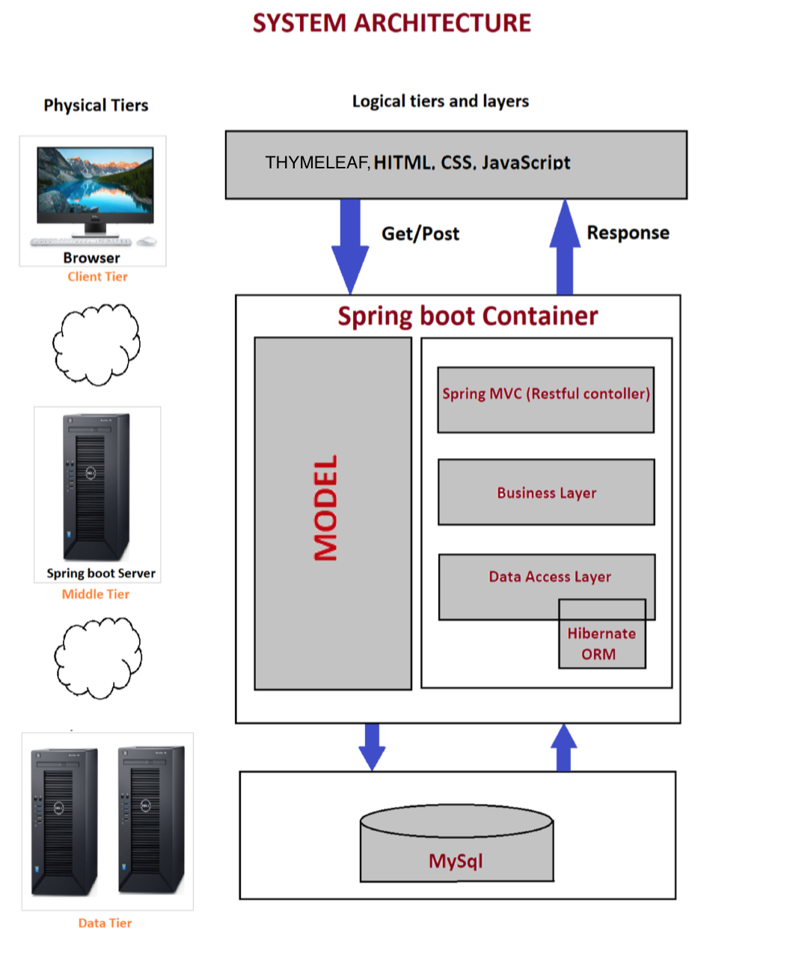

Slide 13
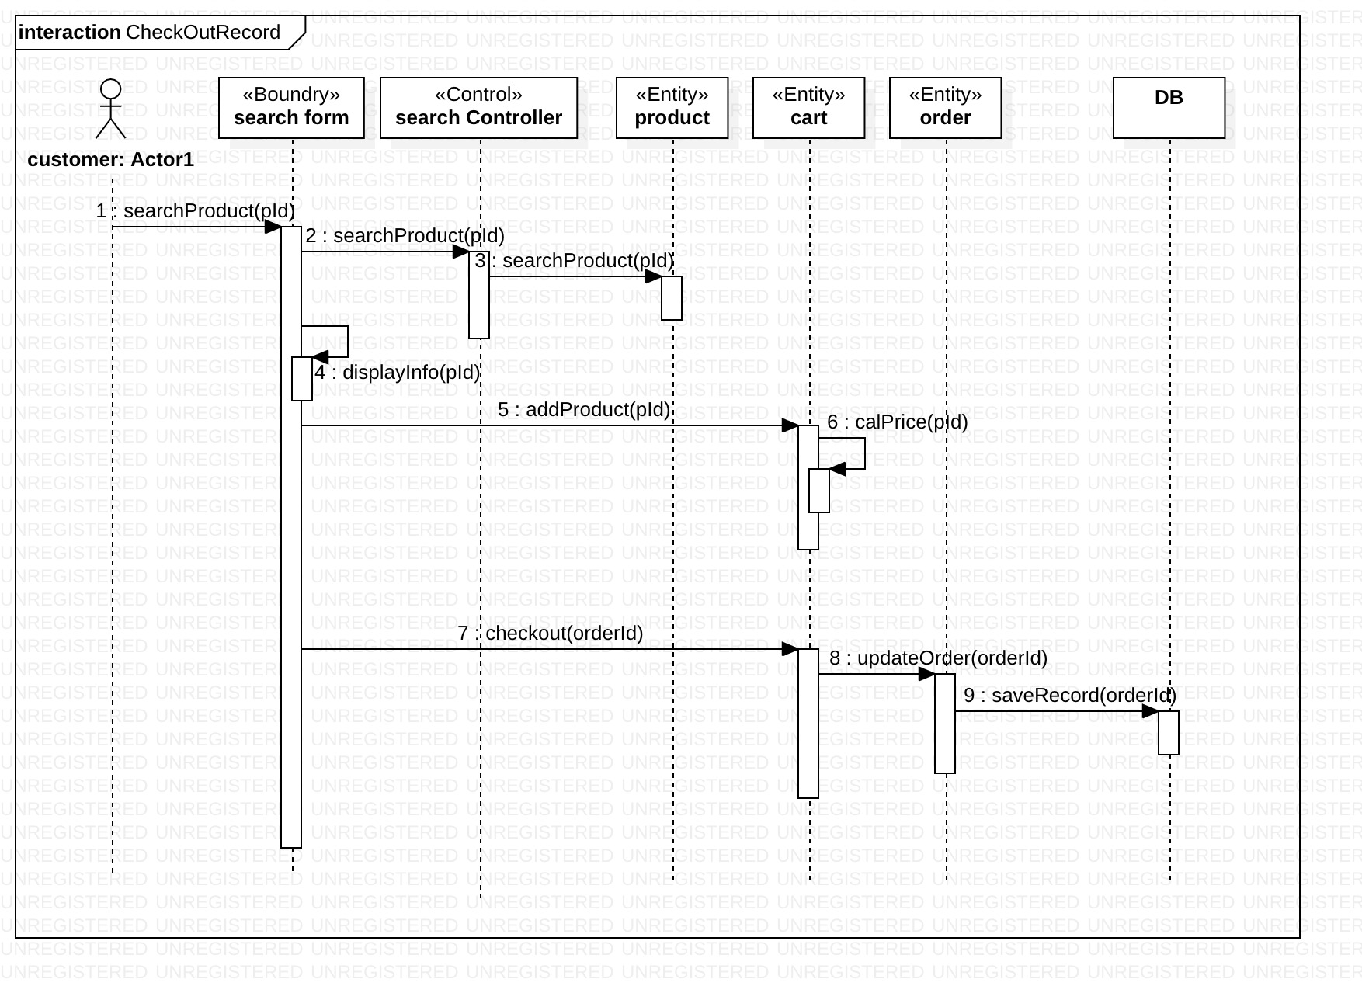

Slide 14
Future Enhancement
Business Domain:
User Security and customer Promotions
Payment
Technologies:
Spring Cloud and Microservices.

Slide 15
Demo To be Continue ...

Slide 16
Additional Futures
Java mail service:- JavaMail API and Java Activation Framework (JAF) installed on your machine.
Internationalization:- is a process that makes your application adaptable to different languages and regions without engineering changes on the source code. In thier words.
Lombok (Maven Dependency):- Automatic Resource Management, automatic generation of getters, setters, equals, hashCode and toString, and more!

